Slide 1
Chap 9 Virtual Memory
Zhenbang You
12/04/2021

Slide 2
Outline (Part I)
Address space
Paging – implementation of address space
Page table
Page table entry
Optimization of paging
Time opt: TLB
Space opt: multi-level page table

Slide 3
Outline (Part II)
Page fault
Memory mapping
Fork
Execve
Mmap/munmap

Slide 4
Outline (Part III)
Dynamic memory allocation
Malloc/free
Garbage collection

Slide 5
Outline (Part IV)
Memory safety

Slide 6
Part I

Slide 7
Address space
An address space is an ordered set of nonnegative integer addresses
Why address space
Easier linking and loading
Protection
Sharing
Easier physical memory allocation
Address space is the abstraction of main memory, swap space, memory-mapped I/O ports, and ROM
Not the abstraction of main memory and I/O devices, as stated in CSAPP

Slide 8
Paging
Address space is just an abstraction provided by the OS
Paging is its implementation
Not the only possible implementation
Core issue of paging
How to translate virtual address into physical address?
Page table
Not the only solution

Slide 9
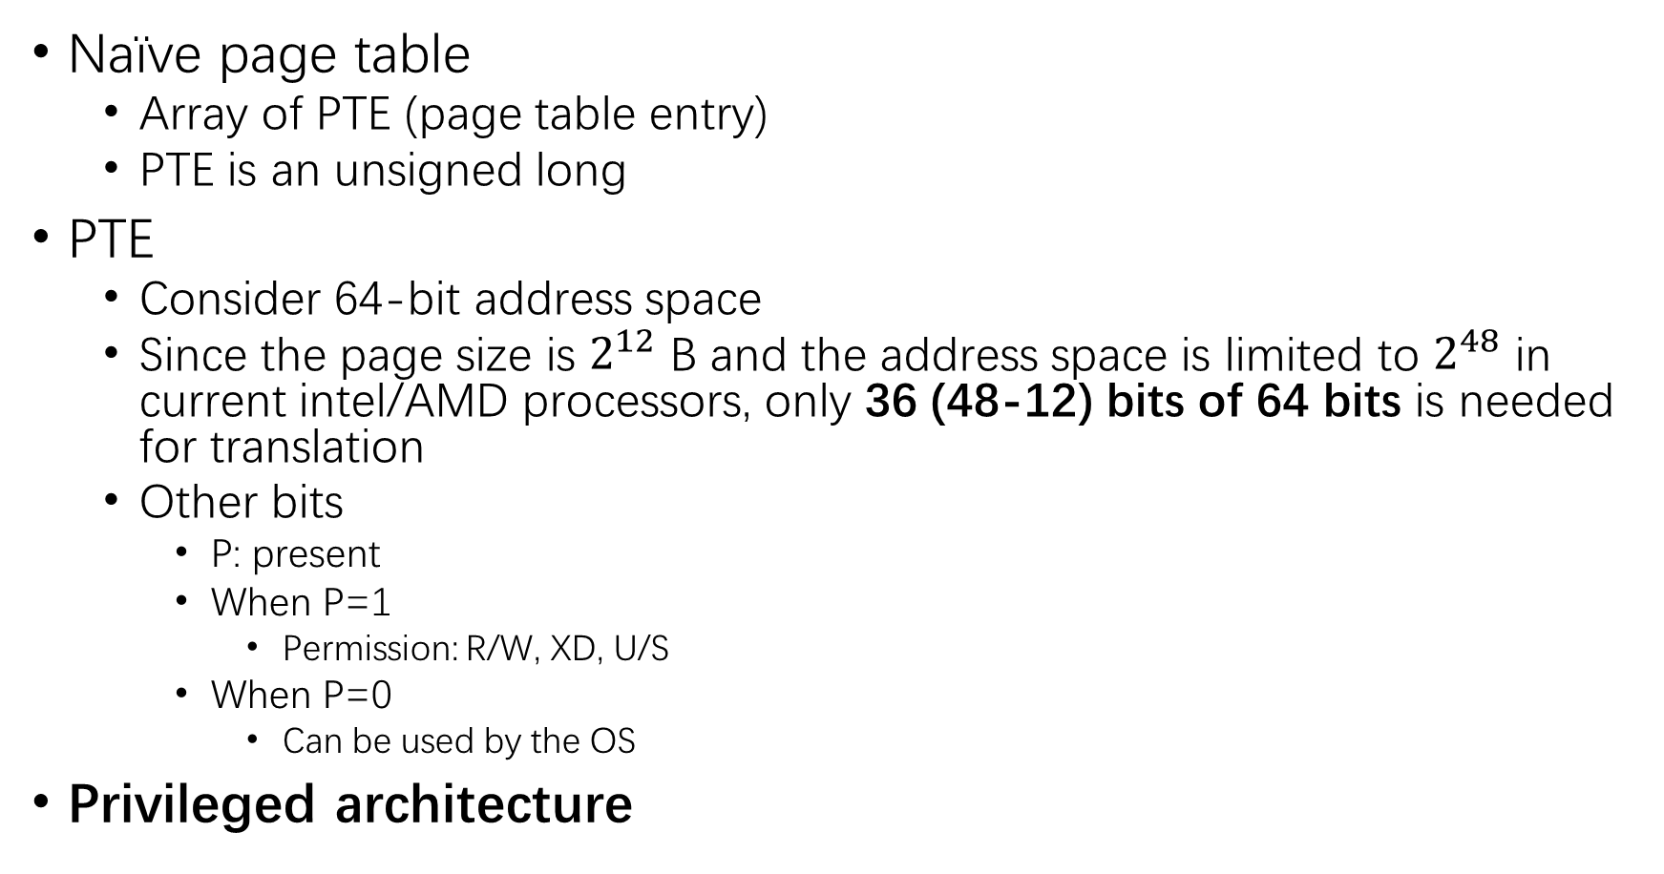
Page table
Naïve page table
Array of PTE (page table entry)
PTE is an unsigned long
PTE
Consider 64-bit address space
Since the page size is $2^{12}$ B and the address space is limited to $2^{48}$ in current intel/AMD processors, only 36 (48-12) bits of 64 bits is needed for translation
Other bits
P: present
When P=1
Permission: R/W, XD, U/S
When P=0
Can be used by the OS
Privileged architecture

Slide 10
Optimizations of page table
Time optimization
TLB
Indeed a cache instead of a buffer
Should be cleared when the address space is switched
L1 TLB: i-TLB, d-TLB, L2 unified TLB
Space optimization
Multi-level page table

Slide 11
Part II

Slide 12
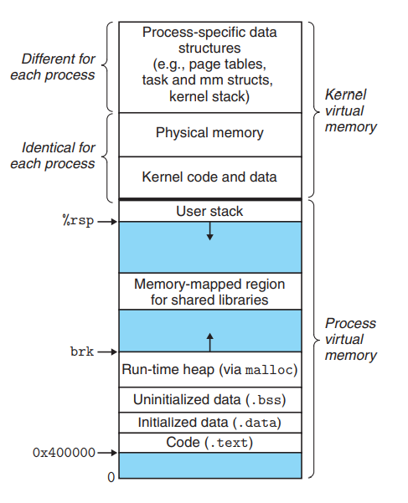
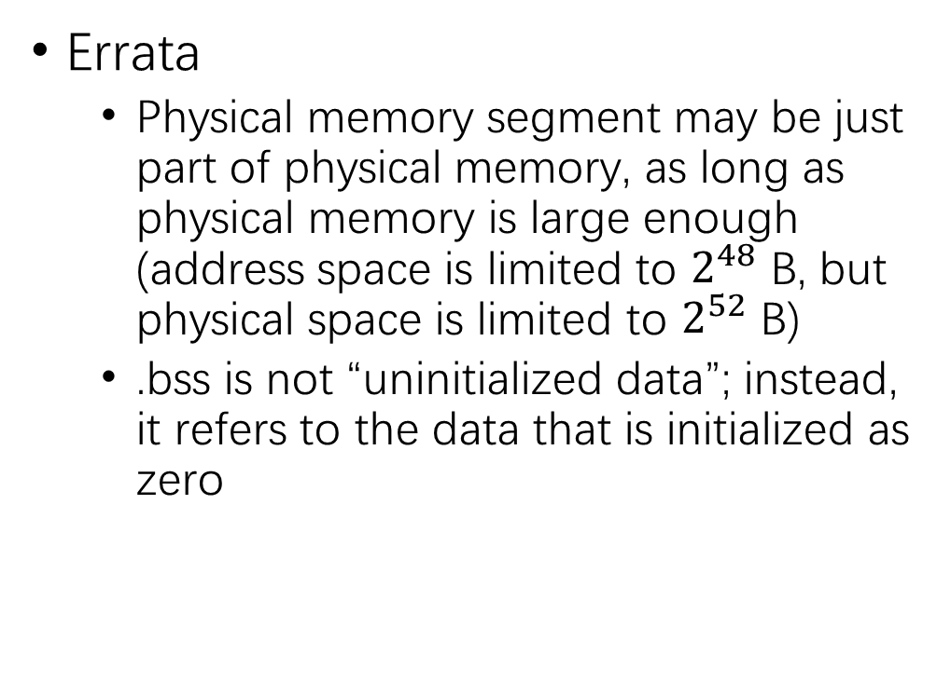
Linux address space
Errata
Physical memory segment may be just part of physical memory, as long as physical memory is large enough (address space is limited to $2^{48}$ B, but physical space is limited to $2^{52}$ B)
.bss is not “uninitialized data”; instead, it refers to the data that is initialized as zero

Slide 13
VMA (virtual memory areas)
Linux organizes the virtual memory as a collection of areas (also called segments)
However, the hardware is not aware of this. This is just the organization of the OS
Address space can be implemented by paging or segmentation. Do not mix segmentation with segments in Linux. The former is a mechanism supported by both the hardware and the OS

Slide 14
Memory management data structures – a programmer’s perspective
From a programmer’s perspective, there are two relevant data structures
Page table
Vm_area_struct

Slide 15
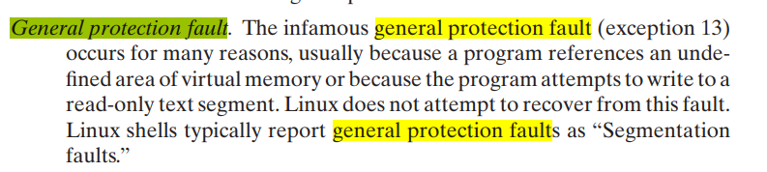
Page fault
Page fault refers to not only the missing of physical pages, but also the violation of permissions
The below is not General Protection Fault, but Page Fault!
CSAPP is wrong again!

Slide 16
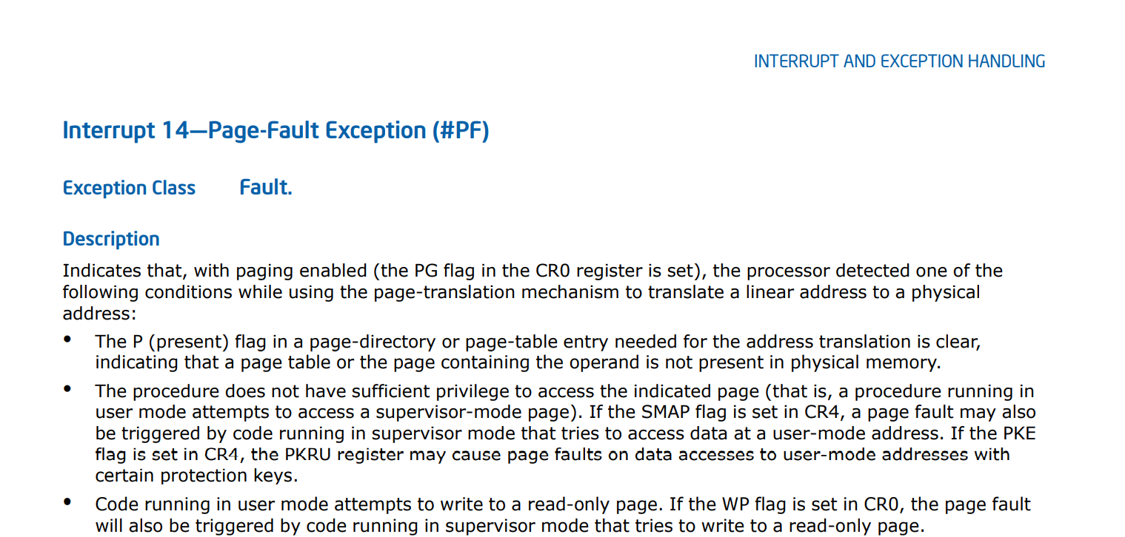
Page fault
Page fault is an exception defined in the privileged ISA
The below comes from intel manual

Slide 17
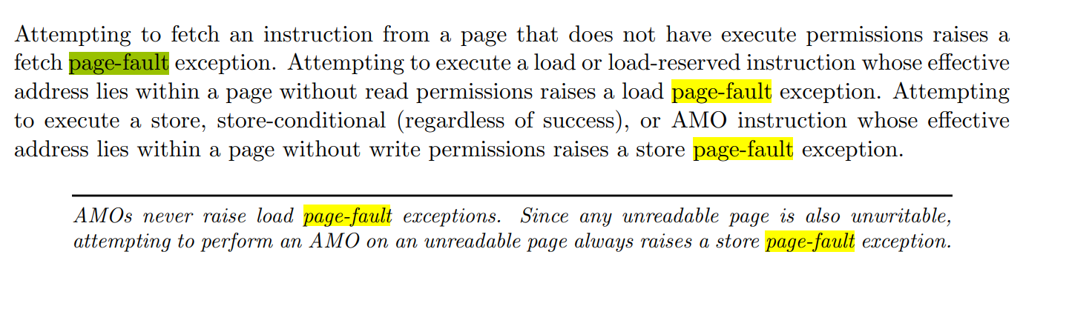
Page fault
The below comes from RISC-V specs volume II

Slide 18
Page fault categories (basic)
Invalid address
E.g., NULL (0)
Permission violation
R/W, XD, U/S
Page not in main memory
What bits in PTE should the hardware check？
1st step: P
2nd step: R/W, XD, U/S

Slide 19
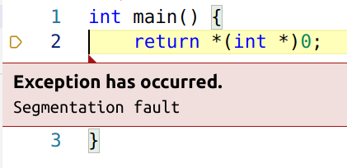
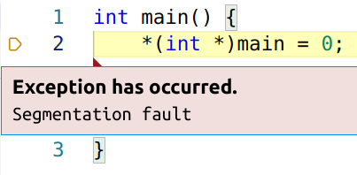
Segmentation fault
Just a signal, not an exception – UNIX specific!
Some page faults will trigger this signal
Invalid address
Permission violation

Slide 20
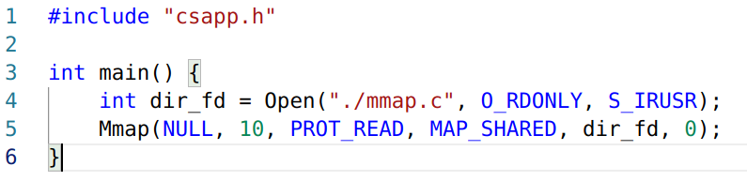
Memory mapping
Regular files
Directories cannot be mapped by mmap
Output: mmap error: No such device
Anonymous files
Does nothing with disks

Slide 21
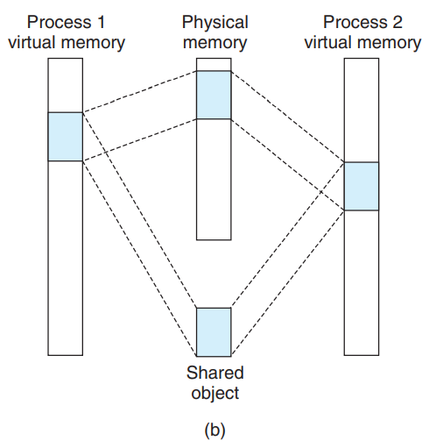
Sharing object

Slide 22
Process creation
Fork
COW (copy on write)
Execve

Slide 23
mmap
https://man7.org/linux/man-pages/man2/mmap.2.html

Slide 24
Part III

Slide 25
Why dynamic memory allocation (I)
Three reasons
The most fundamental one
Life cycle
The life cycle of objects may exceed that of its creator (a stack frame)
There are three kinds of life cycles in C
Automatic
Objects in stack
Dynamic
Objects in heap
Static
Objects in .data, .bss segments
This is not mentioned in CSAPP!

Slide 26
Why dynamic memory allocation (II)
Three reasons
Variable-length objects
Can be placed in stack by variable-size stack frame (chap 3.10.5)
It can be done! Although inefficient. Also insecure in C.
Contradicts what CSAPP asserts!

Slide 27
Why dynamic memory allocation (III)
Three reasons
Large objects
May cause stack overflow if placed in stack

Slide 28
Why dynamic memory allocation (IV)
Escape analysis
JVM
Go

Slide 29
Managing heap
Three ways
Managed manually
C/C++
Managed at runtime (Garbage collector)
JVM, Go, Python
Managed at compilation time
Rust
The last one is not mentioned in CSAPP!
Since it is a cutting-edge technique

Slide 30
Dynamic memory allocation API
Malloc/calloc/realloc
Initialization
Calloc is preferred
Or C++ new
Free
Brk/sbrk

Slide 31
Goals of dynamic memory allocator
Throughput
Utilization
Fragmentation
Internal fragments
External fragments

Slide 32
Implementation
Lists
Implicit lists
Explicit lists
Segregated lists
Fit
First fit
Next fit
Bets fit
Worst fit
Buddy system
Popular in physical memory allocation

Slide 33
Some issues
What about dynamic memory allocation in concurrent programs?

Slide 34
GC (Garbage collection)
Reachability graph
Mark & Sweep
Why is this not adopted in C/C++?
Why not reference count? Like shared_ptr in C++?
Circular reference

Slide 35
Part IV

Slide 36
Memory Safety
https://en.wikipedia.org/wiki/Memory_safety
Life of an object
Allocation -> assignment -> access -> release
If any of them is abused, or if the order is not obey, memory-safety issues will occur!
Teaching suggestions
Analyze by examples
Comparing C with another memory-safe language is highly recommended, like
Java. Its basic grammar is similar to C++
Python. Students are all familiar with it
Go. Simple Grammar. Also its grammar is similar to C

